Slide 1
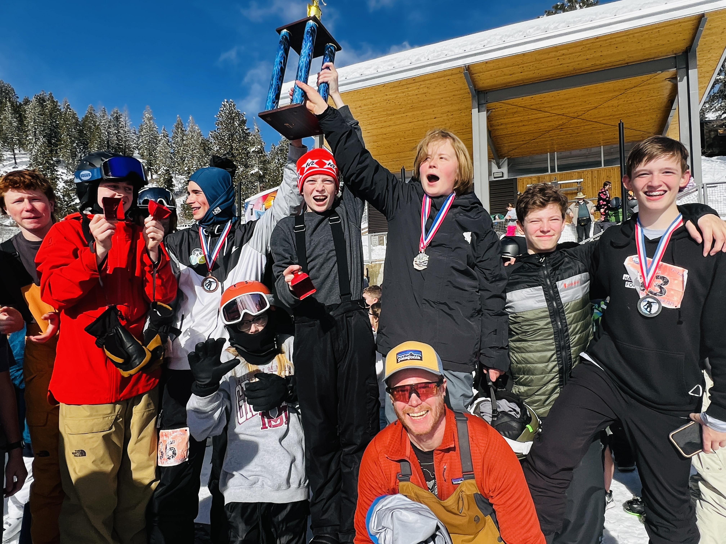
WELCOME BACK!
Riverglen Junior HS 2025 Bogus Basin Champions
BOGUS BASIN SCHOOL RACE PROGRAM 2026
Welcome to the 2027 Dotty Clark Championships & the Bogus Basin School Race Program

Slide 2
Table of Contents
Pages | Reference |  | Pages | Reference
2 | Table of Contents |  | 36 | Essay Contest
3 | Program Goals |  | 37 | Snow Dance Party
4 | Program Contacts |  | 38 | St. Luke's Helmet Decorating Contest
5 | Advisor Responsibilities |  | 39 | Fund Raising - Ski Wax Night Info
6-7 | Student Registration & Deadlines |  | 40 | Intermountain High School Ski Race
8 | Concussion and Injury Protocols |  | 41 | SOAR Special Olympics Athelet Racers
9-10 | Emergencies on the Mountain/Ski Patrol Contact |  | 42 | Soldier Mountain Student Days
11-12 | Parent Responsibilities |  | 43-44 | Ski Idaho Passport 5th & 6th Grade
13-18 | Season Schedule - Family Practice Days - Race Start times & Tentaive Dotty Clark Schedule
19-20 | Racecourse Locations and Map
21 | Disciplines and Skill Levels
22-25 | Team Scoring and Dotty Clark Seeding
26-30 | Day Passes and Pricing
31 | Programs for Students with financial difficulties
32 | Helmet Information
33 | Buses
34 | Tailgating Info
35 | School Nights and Life Sports Info

Slide 3
THE PROGRAM’S PHILOSOPHY HAS THREE GOALS:
Provide a safe environment on the slopes in which to participate.
Encourage students to represent and compete for their school in a life sport activity. This provides a venue for many students to represent their school that might not otherwise.
Provide a level of competition in which the maximum number of students can participate.

Slide 4
BOGUS BASIN SCHOOL RACE PROGRAM CONTACT LIST
Your primary contact is your school Advisor:
Advisor Contact info insert here
There is a contact list link on the front page of the website listing all school Advisors and school contact info
For urgent matters contact:
Race Coordinator: John Foley: 208 870-4488

Slide 5
ADVISOR RESPONSIBILITIES:
Encourage participation, hold meetings, promote the program at your school. Advisors are encouraged to hold at minimum, one parent meeting
Attend the practice Saturday, 6 Saturday Races and your respective Dotty Clark race.
Verify Racers for your school. Racers MUST BE ON THE ROSTER to be eligible to race.

Slide 6
Student Registration Deadlines
Online Registration:
Student Registration Deadlines:
    1st Race registration deadline is December 28th, 2026
    All add-ons/new racers will register online via student registration.
  If a student needs to make changes or add a discipline:
    After December 28th changes must be emailed to Vickie Woodward by 5:00 PM on the Wednesday before their next race.
  If a Student registers after December 29th they will be eligible to participate in the second race and all following races.
      A student must register prior to 5 PM on the Wednesday before that weeks Saturday race in order to be eligible to compete that week
    February 3rd at 5 PM is the last day to register for the 2027 season.

Slide 7
Registration Deadlines for New Racers and Changes for Registered Racers
A student’s Parent or Guardian must register their student online to join the program.
  Students 18 years or age or older can register themselves
A parent or Adviser can log-in and make changes such as:
Add a Discipline
Change a skill level
Changes must by made by 5:00 PM on the Wednesday before that Saturday's race.
Registrations during the race season must be completed by Wednesday, 5:00 PM before that Saturday’s race.
(For example, Mikaela Shiffrin wants to race January 23rd, 2027 and submits her registration at 4:59 pm Wednesday, January 20th, 2026. She is good to go!)
NO add-ons will be allowed to race if they did not complete the online registration by Wednesday, 5 pm before they race.
(For example, Bode Miller wants to race January 23rd, 2027 and submits his registration at 5:01 pm Wednesday, January 20th, 2027. Sorry Bode, you are not eligible for the January 23rd race.

Slide 8
Concussion Protocol Responsibilities & Injuries
  A Student cannot return to competition unless they are released by a medical professional (MD, DO, PA or Advanced Practice Nurse if a concussion is suspected
  The students Adviser and John Foley will conduct the concussion protocol to ensure the student is cleared to return to participate in the program.
  Either your Adviser or John Foley will email you the Return to Sport Release. This can also be found on our website, BBSRP.com
  Racecourse Managers are required to report any injuries to John Foley, Race Coordinator

Slide 9
Emergencies on the Mountain
Call Ski Patrol at this number:
  208 332-5350
  Patrol can find you on the mountain using your cell phone signal.
  Give this number to all students and parents
  This is like dialing 911 on the mountain so please only use this for emergencies

Slide 10
Emergencies on the Mountain
  If your student is injured on the mountain, we will contact your school Advisor who will contact the student’s parent or guardian.
  If we cannot contact your school Adviser John Foley will call the student’s parent or guardian.
  We will have your school adviser meet your child at Ski Patrol or one of our staff will stay with your child at Patrol

Slide 11
PARENT RESPONSIBILITIES:
Online Registration
Easiest way to register or get info about the program go to:
bbsrp.com
Second method:
    Go to the Bogus Basin website
    Go to: Your Mountain
    Go to: About Bogus
    Go to: Competitive Education
    Go to: Bogus Basin School Race Program
    Scroll down to Middle School or High School Registration
  You must respond to each question to move on
    Parents must fill out the registration unless the student is 18 years of age or older.
    Registration Site
Liability Forms
    All Liability and Concussion Protocol forms will be on-line and a part of the Adviser and Student registration forms. Parents registering a student will not be able to move to the next section of the form without viewing and agreeing to the Liability, Concussion Protocol and Release of information forms.

Slide 12
PARENT RESPONSIBILITIES:
    Parents can make changes to their student's discipline and skill level on the website.
    Log in to make changes
    Changes prior to the first race
      Deadline is Monday, 12/28/26 by 5 PM
    Changes after the first race
      Changes must be made by 5 PM on the Wednesday prior to that Saturdays race.

Slide 13
2027 SCHEDULE FOR ALL RACE DAYS
12/28/26 at 5 PM Last Day to register to be eligible for the 1st race
      Registration for the 2026 Season will close on 2/3/27
    Saturday, January 9th ,2027 Family Race Day All racecourses open
Saturday, January 16th, 2027 Race #1
Saturday, January 23rd, 2027 Race #2 Snow Dance Party
Saturday, January 30th, 2027 Race #3
Saturday, February 6th, 2027 Race #4
Saturday, February 13th, 2027 Race #5 St. Luke's Helmet Contest
Saturday, February 20th, 2027, Race #6
Thursday, February 25th, 2027, High School Dotty Clark
Friday, February 26th, 2027, Middle School Dotty Clark

Slide 14
2027 SCHEDULE OF EVENTS
Competition Time Location
Nordic 10:00 Frontier Point Lodge (Nordic Center)
Freestyle HS -10:30 MS/JH -11:15 Playground
Special Olympics races 10:00-10:30 Alpine
Practice Racecourse for all 10:30 – 12:00
Snowboard Expert HS:12:30 MS/JH - 12:45 The Bowl
High School Slalom Ski & Snowboard 12:30 See Trail Map
Middle School Slalom Ski & Snowboard 1:30 See Trail Map
High School Alumni Race 2:30 Ski on Alpine Snowboard on Sourdough

Slide 15
Pre Race Family Practice Day
When: Saturday, January 9th, 2027, Courses open from 11:30 – 1:30
  All students, parents and siblings can run the racecourses during the 2-hour practice session
  We will set up timing units and call out times
Where: All Racecourses – See Racecourse Map
High School Team 11:30 - 12:30
Middle School/Junior High School 12:30 – 1:30
Freestyle team will be on sight from 11:30-12:30
What: Students will have the opportunity to run any racecourse to make sure they are registered for a racecourse they feel comfortable competing on
All students with a 2027 helmet sticker can go directly to the racecourse. If the student does not have a current helmet sticker and is registered, they need to get a wristband from the 3rd floor of Bogus Creek Lodge.
Waivers will be available for parents, students and siblings to obtain a wristband and run the racecourses. Go to the 3rd floor of Bogus Creek Lodge.

Slide 16
Thursday Night Family Practice
Registration begins at 5:15 PM on the 3rd floor of Bogus Creek Lodge
Students with a Helmet Sticker can go directly to the racecourse on Alpine
Parents and Siblings must register and sign the Liability waiver to obtain a wristband to participate.
When: Races run from 6 PM to 7:30 PM on Thursday Nights
Where: Alpine Run
See Dates on following slide

Slide 17
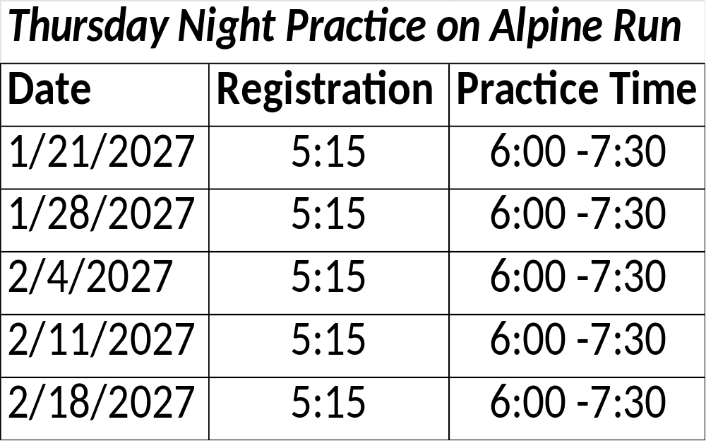


Slide 18
Tentative 2027 DOTTY CLARK DAILY SCHEDULE
9:00 AM – Deerpoint, Show Case and Morning Star Chairs opens for racecourse setters only
9:30 AM – Deerpoint, Show Case and Morning Star Chairs open
9:45 AM – Freestyle (SBE Competitors go first)
10:15 AM - Snowboard Expert (SBE)
10:30 AM – Slalom Races
12:30 PM – Nordic Races
2:00 PM – Awards will be hosted in the flats in front of Simplot Lodge
RACERS WILL NEED TO RACE A MINIMUM OF 3 SATURDAY RACES TO QUALIFY FOR DOTTY CLARK.
RACERS CAN COMPETE IN ALL FIVE DISCIPLINES AT DOTTY CLARK IF THEY QUALIFIED IN ALL FIVE DISCIPLINES. 3 races in INT, 3 in SBN, 3 in NEX, 3 EACH in FREESTYLE SKI and SNOWBOARD

Slide 19
RACECOURSE LOCATIONS
Discipline Abbreviation Location
Expert Ski EXP Cascade
Advanced Ski ADV Mambo Meadows
Mid Level Ski & SOAR* MID Alpine
Intermediate Ski INT Claim Jumper
Novice Ski NOV Sunshine
Snowboard Expert SBE Upper Ridge - Skiers Left
Snowboard Intermediate SBI Sourdough – Skiers Left
Snowboard Novice SBN Sunshine
Freestyle: FSE, FSI, FBE, FBI Playground
Nordic: NEX, NIN, NNO Frontier Point Nordic Center
*SOAR – Special Olympics Athlete Racers

Slide 20
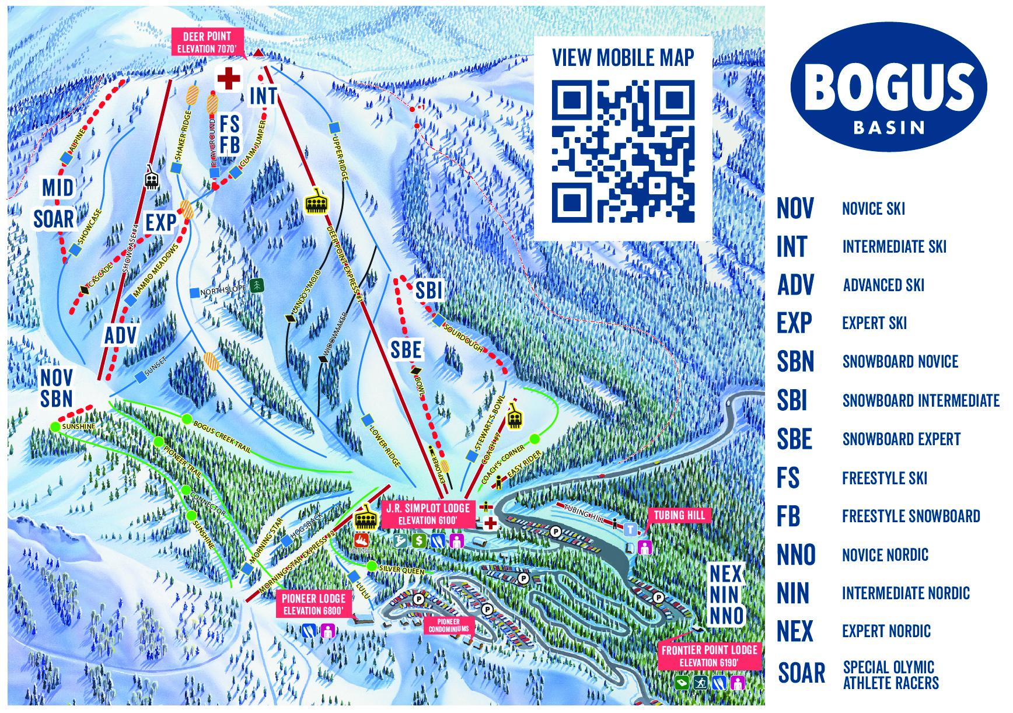
RACECOURSE MAP

Slide 21
DISCIPLINES AND SKILL LEVELS
Ski Slalom
EXP – Expert Ski
ADV- Advanced Ski
MID- Mid level Ski
INT – Intermediate Ski
NOV – Novice Ski
Freestyle Ski
FSE – Freestyle Skier Expert
FSI – Freestyle Skier Intermediate
Snowboard Slalom
SBE – Expert Snowboarder
SBI – Intermediate Snowboarder
SBN – Novice Snowboarder
Freestyle Snowboard
FBE – Freestyle Snowboarder Expert
FBI – Freestyle Snowboarder Intermediate
Nordic
NEX – Nordic Expert
NIN – Nordic Intermediate
NNO – Nordic Novice

Slide 22
TEAM SCORING SYSTEM
The Saturday races will be divided into 2 Divisions again this year. Each racer can earn up to 10 points for their school for each race: The more racers, the more points. Points are awarded for Saturday Races by the following criteria:
      10 pts – 100% > 90% of the fastest time
      9 pts – 89% > 80% of the fastest time
      8 pts – 79% > 70% of the fastest time
      7 pts – 69% > 60% of the fastest time
      6 pts – 59% > 50% of the fastest time
      5 pts – 4 9% > 40% of the fastest time
      4 pts – 39% > 30% of the fastest time
      3 pts – 29% > 20% of the fastest time
      2 pts – 19% > 10% of the fastest time
      1 pt – Finished race or Disqualification

Slide 23
TEAM SCORING SYSTEM
The Dotty Clark Championships will also be split into Large & Small School Divisions. A team trophy for the champion and individual medals will be awarded for 1st, 2nd & 3rd places in each division and for each category.
School size is decided according to roster. Small School is defined as any school with 25 or less student categories (a student in two categories counts as two students) and Large School is any school with 26 or more student categories.
School Size is not defined by racers but by your roster at the end of week 4 of the season.
Team Trophy Determination
Dotty Clark School Championship
  Total points earned at Dotty Clark will determine large and small school winners.
Bogus Basin School Race Program Champion
  The highest average points per race for the entire season:
    Determined by total points for the season earned by all racers in all categories divided by the number of racers on your roster after week 4.
  To be eligible for this award a school must have a minimum of 5 race entries for small school and 15 for large school trophies.
*Download the Brower Timing App and get live times if you are within 30 feet of the finish line.

Slide 24
Bogus Basin Trophy
Monza High | Race 1 | Race 2 | Race 3 | Race 4 | Race 5 | Race 6 | Dotty Clark | Tota Points | Students On Roster at the end of the 4th Race | Total Points divided by # of Racers on Roster after Race #4 | Team Average
Points | 110 | 97 | 115 | 95 | 114 | 102 | 124 | 757 | 18 | 757/18 = 42.05 | *42
Racers | 17 | 16 | 19 | 18 | 18 | 17 | 17
Silverstone High | Race 1 | Race 2 | Race 3 | Race 4 | Race 5 | Race 6 | Dotty Clark | Total Points
Points | 481 | 513 | 453 | 463 | 419 | 433 | 458 | 3220 | 77 | 3220/77=41.8 | 42
Racers | 80 | 88 | 76 | 74 | 77 | 73 | 69
Max Verstappen competes in EXP, SBI and FSI = 3 on Roster
Fernando Alonso competes in SBN and NNO = 2 on Roster *Monza HS wins 42.05 vs 41.8

Slide 25
Dotty Clark Bib Seeding
Racers who have participated in 6 events in that discipline go first followed by those with 5, 4 and 3 races.
  A student with the fastest average time of the 6 races goes first followed in order after that.
Female Racers go first using the same criteria for seeding
If you have racers competing in multiple events allow them to go ahead of other racers. You can identify them as they will have multiple bibs.

Slide 26
Day Tickets and Discounts
  Student Day Tickets are $29.00/day (plus tax) $30.74 including tax
  Students on the school roster are guaranteed a day pass on race days
  This day pass is good from Open to Close on the mountain
All Day Passes will be purchased on-line
  Parents of students without a Season Pass will be emailed a link that will be used to enable you to purchase tickets for School Race Program Days at the reduced price.
  Plan on spending up to 15 minutes registering on the Bogus Basin website when setting up your account
    After you register you will be able to reload your student's media card/day pass, and it will be much faster
    .

Slide 27
Discounts on Nordic and Rental Equipment
Rental packages (not individual pieces of equipment) $4.00 off.
Rental Pricing is listed on the Bogus Basin website
Students with financial difficulties can get free rental gear. Contact your students school Adviser
Nordic
    Season Pass holders can add Nordic for $25.00
    $5.00 per race on individual race basis.
    Rental gear is free for race only
    We have plenty of Nordic gear

Slide 28
Day Pass Media/Card Information
Online Ticket Purchase & Redemption Process
Step 1: Purchase tickets online
You’ll receive a secure URL at a later date. From that link you will:
Create a guest profile and upload a photo
Select ticket quantity and dates
Sign the waiver
Complete your purchase
Step 2: Save your confirmation email
The confirmation email includes your receipt and a QR code. Make sure you can access the QR code when you’re on the mountain, either printed or saved on your device (cell service can be untrustworthy).
Step 3: Pick up your ticket
Location: ICCU Plaza in the Bogus Creek Base Area, formerly Simplot Lodge
Get Ticket
Scan your QR code at the kiosk/Pub.
Collect your ticket from the kiosk.
Enjoy the mountain!

Slide 29
Day Pass Media/Card Information
DO’S
Keep the ticket by itself in a jacket pocket.
Have the ticket in your pocket as you approach the lift gate.
Save your ticket for future visits and reload it online:
  Reload day tickets, summer activities, or next year’s season pass/tickets on this card.
DON’TS
Do not hole punch the card.
Do not store it with your wallet, phone, keys, etc.
Do not carry other passes or RFID cards in the same pocket.
Do not throw away the card.
If the card is lost, it can be replaced for a $10 fee.

Slide 30
Day Pass Media/Card Information
All day passes will be issued as a media card that can be reloaded
Does the student have to be present to pick it or can someone pick it up for them?
NO, but the product will be picked up on the mountain from one of our ticket pubs. Whoever is picking up the access media card/ticket will need to scan the QR code at the pub. The pub/ticket card dispenser will spit out the card and the student/guest will go directly to the lift.
Media cards will only be available on the mountain at the ICCU Plaza – Outside Bogus Creek Lodge, formerly Simplot Lodge
The cards can only be picked up and printed at the pubs/card dispensers located on the ICCU plaza (lower lodge patio). The parent will receive a QR code in a confirmation email after purchasing the ticket(s) online. They will need to give that QR code to the student and the student will scan the QR code on the mountain at a pub/ticket dispenser. The student/guest will go directly to the lift after they receive the card. I would advise that parents either print off the QR code or have the student take a picture of it on their phone. The student will only need to go to the pub on their first day as the tickets that are purchased will be on the card and any additional tickets can be reloaded onto that same card, there is no need to visit the patio or the pubs once the card is issued to the student.

Slide 31
Programs for Students with Financial Difficulties
Free Day Passes
Rental Equipment
Contact Your School Advisor for more information
Advisors – You will denote a student who qualifies for this program on the website, a check box.
Advisors will only have visibility to their school. This information will not be visible to anyone else in the program with the exception of those administering it.
We will confirm acceptance in the program

Slide 32
Helmet Information
HELMETS ARE REQUIRED FOR SLALOM & FREESTYLE.
Helmets are Not Required for Nordic

Slide 33
BUSES
$10.00 per person round trip or one way (CASH ONLY)
  Locations and times – go to the Bogus Basin website and select Getting Here and scroll down.
  First come first served
  Anyone riding the bus is guaranteed the ability to purchase a lift ticket for themselves if we sell out on-line for that day.

Slide 34
Tailgating
Areas where tailgating is allowed on Saturdays
  Buttercup and Silver Queen Parking lots
  Along the edge of the cat track
  Dotty Clark
  Along the road above the flats to the east of Bogus Creek Lodge, above the ski racks
  You will need to reserve one of these spaces with John Foley
Where tailgating is not allowed
  In parking spaces in any of the parking lots (No taking up an extra space to tailgate)

Slide 35
SCHOOL NIGHTS & LIFE SPORTS LESSONS
The Life Sports programs are offered to school groups that would like to plan skiing and snowboarding lesson trips to the Mountain. This program includes rentals, lift tickets, and lessons for participants. Life Sports offers day and evening opportunities.
Registration opens October 7th.
Dates available to book start January 5th through March 12th, 2027.
For 3rd -12th grade students only (ages 7 – 18) and is not designed for adults or young children.
Transportation will not be provided by Bogus Basin.
Available for all abilities.
Minimum group size of 20 or more.
Go to Group Sales on the Bogus Basin website for more information
Group Sales contact Denali Minnick denali@bogusbasin.org 208 332-5119

Slide 36
BOGUS BASIN ESSAY CONTEST
Win a Season Pass for the 2027-2028 season
Bogus Basin School Race Program Essay Contest
High School and a Middle School Winners
Essay Question:
Imagine the perfect Saturday at Bogus Basin with your School Race Program team. What would the day look like, from arriving at the mountain to your final run?
One essay per student racer submission allowed
Must compete in at least 3 races and Dotty Clark to be eligible.
Email essay to: bogusbasinessay@gmail.com
Subject line: Essay Entry
Name, Grade, School you attend and question at top of page
No more than 350 words, 12-point Arial or Times New Roman font, double spaced.
Please do not use AI as we will review for AI usage. These essays could be disqualified.
  Students must follow the format criteria to be eligible to be judged
Deadline for submission is 2/21/27.
Winners will be announced at The Dotty Clark Championship race
Contact your school Adviser if you have questions

Slide 37
SNOW DANCE CONTEST AND PARTY
When: 10:00 AM January 23rd, 2027
Where: The Flats outside Bogus Creek Lodge
What: The school with the best snow dance team will win: TBD
Best Adviser Snow dance – The Adviser with the best snow dance will win TBD
    Judging for the best Adviser snow dance will be done by crowd noise, so make sure your team is there to support you.
    Questions Contact: Elisa England - elisa.england43@gmail.com

Slide 38
ST LUKE’S HELMET DECORATING CONTEST
When: 10:00 AM to 1:00 PM February 13th, 2027
      Drop off your helmet between 10 AM and 11:00 AM to be judged for the contest at the event table.
Where: The Flats outside Bogus Creek Lodge
What: Decorate a helmet and win prizes for your school
    Helmets are available. Pick up at the Adviser meetings or at the info booth on the 3rd floor of Bogus Creek Lodge on race days
    Contact Elisa England with any questions: elisa.england43@gmail.com
Prizes: TBD

Slide 39
FUND RAISING OPPORTUNITY: WAX NIGHTS
Wax nights are a great opportunity to bring in some funds for your snow team. There is no cost to your school. Bogus Basin supports this program.
Benefits
  School collect between $10.00-$20.00 per pair of skis or board
  Students get hands on experience waxing skis
  Great opportunity to host a parent meeting and get your team together
  We come to you

Slide 40
Bogus Basin Intermountain High School Ski Race
When: Saturday, February 27th , 2027
Where: Bogus Basin
What: Teams from Bogus Basin, Sun Valley, Tamarack, Soldier Mountain and Anthony Lakew will compete in ski racing
    Race will be held on Cascade – Expert Racecourse (Ski only at this time)
    Start will be at 11 AM
    Open to High School Students
    Male and Female Division – Awards after event

Slide 41
Special Olympics Racecourse
Special Olympic Athlete Racers ( SOAR)
We will set up a racecourse for Special Olympians on race days
Time 10 AM – 11 AM
Location: Alpine
First 3 races will not be timed
Last 3 races will be timed

Slide 42

Soldier Mountain Student Days

Slide 43

Ski Idaho Passport
5th and 6th Graders
Ski Idaho - Plan Your Next Trip To One Of Our 19 Idaho Ski Resorts
Idaho's 5th & 6th Grade
Peak Season Passport
New 2026 Passport Pricing
$29 now - Dec. 20.
$49 after.
How it Works
Once applications are open, you will be able to submit your application from our registration page (or the button below), with the one-time $29 processing fee, now through December 20, or $49 after. We’ll e-mail you a passport that gives your 5th grader three free days at 18 locations, or your 6th grader two free days at 18 participating locations.
You can either print the passport and bring it with you or pull it up on your smartphone and present it at the ticket office. Either way, your kid’s skiing free. Of course, a parent or guardian must be present, and the passport must be shown at the resort in order to receive the lift ticket.
Participating ski hills reserve the right to limit passport use for ski racers, on race days and on any scheduled blackout dates that may apply. Check with your ski hill for full details.

Slide 44
Ski Idaho Passport
5th and 6th Graders
Ski Idaho - Plan Your Next Trip To One Of Our 19 Idaho Ski Resorts
We will have voucher codes for these daily tickets.
It would be best for the parent to send an email to: pass@bogusbasin.org
Put the subject as: 5th and 6th grade passport voucher code request.
They would need to send us the child's name and the code they receive from Ski Idaho.
We can send them the vouchers needed for each race day (up to 2 for 6th grade and 3 for 5th grade).
Those voucher codes will be ready closer to when the season starts, so the requests should be made after Thanksgiving.

